Slide 1
PLAN OF ACTION
We have created a portal for the women entrepreneurs who have already benefitted from the loan scheme in order to facilitate the easy and transparent transaction. The portal will contain their personal information that includes their account details along with the loan repayment track record and also the data regarding their economic activities.
Name of the Organization - Ministry of Women and Child Development
Problem Statement Title - Management Information System (MIS) software for IMOs
Problem statement no - AS33
TEAM NAME – RAM256KB
TEAM LEADER NAME – MR VIKASH SINGH COLLEGE CODE-

Slide 2

IDEA DESCRIPTION
We have planned to create a DApp which will contain all the necessary information about the women entrepreneur who have already benefitted from the given loan scheme. The DApp will contain vital details such as loan account information, repayment track record, economic activity, personal information (Aadhar Card, Bank Account Details, Age etc.), Income level, Savings, Demographic details (no. of family members, caste, religion, literacy level etc.) . Moreover, in order to make the entire process a lot more user friendly we have developed the website in multiple languages.
TECHNOLOGY STACK(SOFTWARE)
1.) HTML-CSS
2.) BOOTSTRAP
3.) BLOCKCHAIN
4.) ETHEREUM WALLET
5.) WEB3.js
6.) TRUFFLE NETWORKS

Slide 3
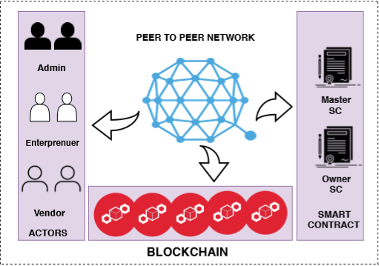
1. All the actors are connected in a peer to peer network which maintains a blockchain and records all kinds of transaction among the actors.
2. The smart contract deployed in the blockchain are responsible to perform crucial functionalities ,such as loan account info,repayment track record ,personal info and more details like occupation,income level,as well as the savings.
3. We have implemented a prototype to analyse the feasability of the proposal .
4. The programming language we are using in the implementation is solidity.
5. We are creating a simple Ethereum DAPP using web3.js and truffle and set up monitoring of the API transaction sent to the Blockchain.

Slide 4
